Slide 1
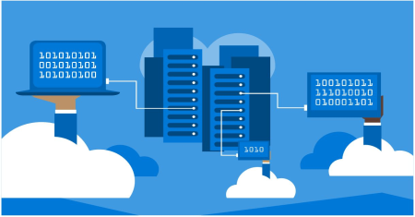
Database Systems
Lecture 1

Slide 2
What is Data??
Raw or unorganized facts and figures (such as alphabets, numbers, symbols).
Example:
Student Data: Roll No, Name, Mobile, CGPA etc.
Faculty Data: Name, Designation, Email-id, Mobile etc.
User Profiles on Facebook, Twitter etc.

Slide 3

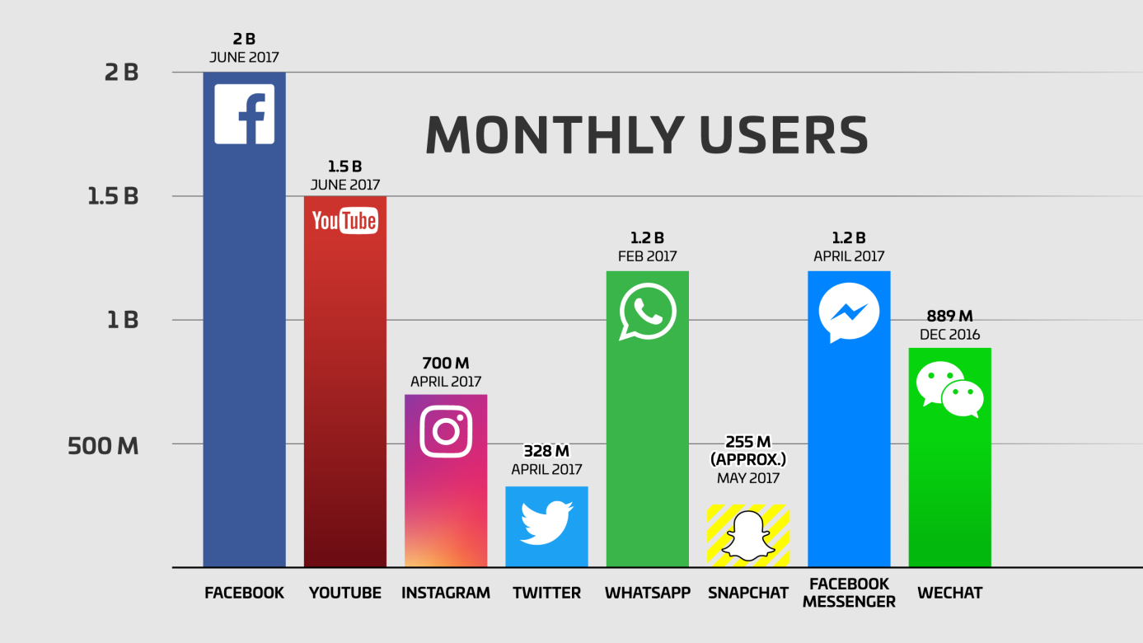
What can be done with Data
What to do with this tremendous data??
Data → Information
Information → Knowledge
Knowledge → Growth of Business/ Organization

Slide 4
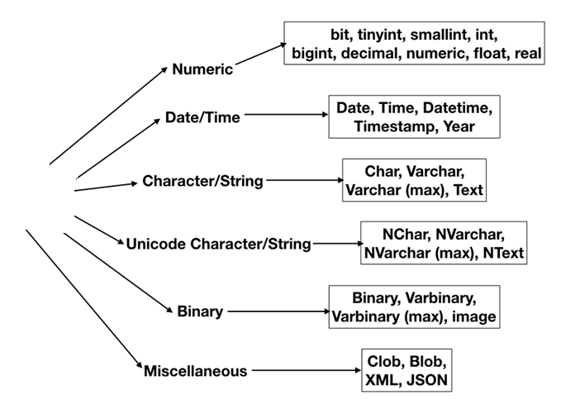
Data Types

Slide 5
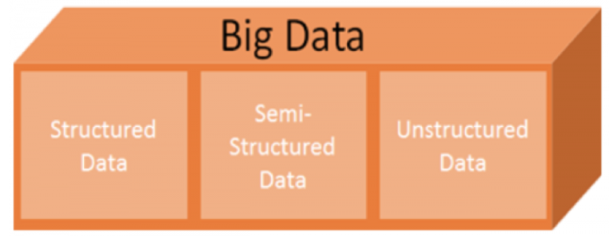



Another Classification of Data

Slide 6
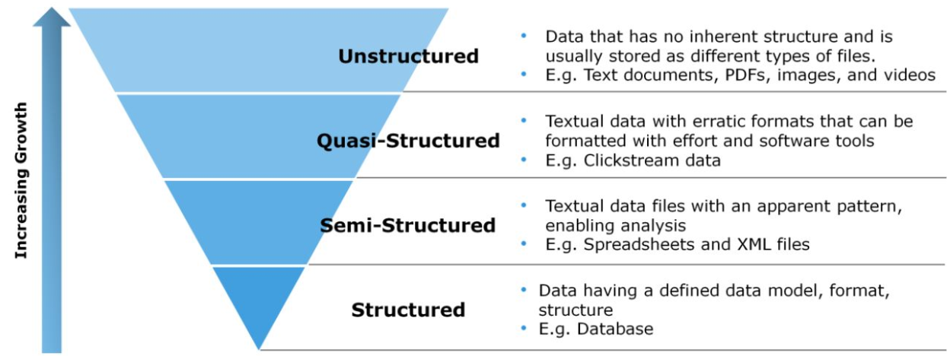
Types of Big Data

Slide 7
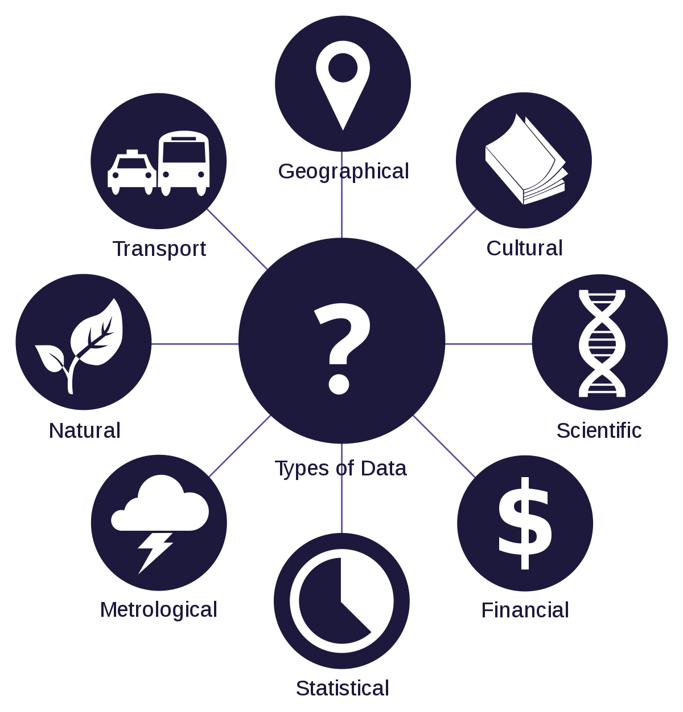
Types of Data – Based on Domain

Slide 8
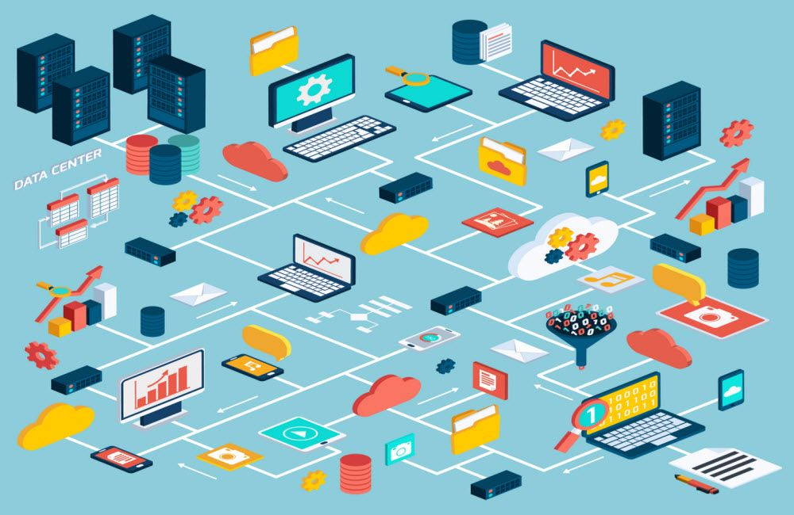
Handling Tremendous Data
Handling this tremendous amount of data is overwhelming.
Thus, we need some automated mechanism to perform this task.

Slide 9
Aspects of Data
Data
Storage
Information Retrieval
- Text Files
- Spreadsheets
- Relational Database (Tabular)
- Key-value Pairs
- Sequential/Manual
- Query Based
- Natural Language Based

Slide 10

Evolution of Data Storage
Data
File Storage
Indexed Storage
Data-warehouse
Cloud Storage

Slide 11
File Storage
Alternatively referred to as a flat database or text database, a flat file is a file of data that does not contain links to other files or is a non-relational database. A good example of a flat file is a single text-only file that contains all the data needed for a program that is often separated by some kind of delimiter.

Slide 12

File Storage…
File handling programs like reading contents of a text file, writing student records in a file are examples of traditional File Storage.
Problems with File Systems:
Data redundancy and inconsistency
Difficulty in accessing data
Data isolation — multiple files and formats
Integrity problems
Atomicity of updates
Concurrent access by multiple users
Security problems

Slide 13
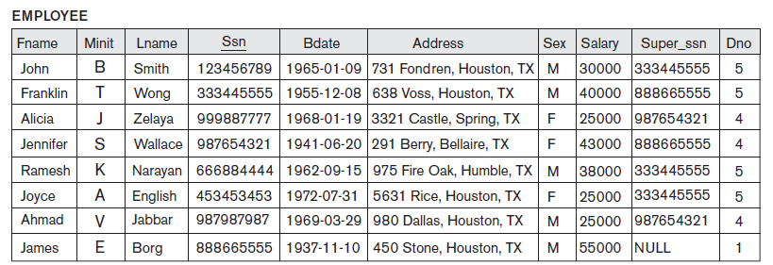
What is a Database?
Collection of related data
Example: Employee Information

Slide 14
Database Management Systems
Database System contains information about a particular enterprise
Collection of interrelated data
Set of programs to create and maintain a database
An environment that is both convenient and efficient to use
USER
User does not interact directly with the database. DBMS acts as a interface between the user and the DB.
Database System
DBMS
DATABASE

Slide 15
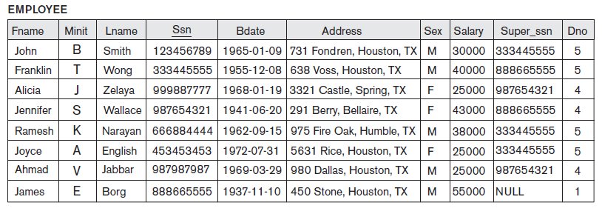
Levels of Abstraction
External Level: application programs hide details of data types. Views can also hide information (such as an employee’s salary) for security purposes.
Accounts
View
Manager
View
Fname | Lname | Ssn
John | Smith | 333445555
Franklin | Wong | 888665555
… | … | …
Fname | Lname | Dno
John | Smith | 5
Franklin | Wong | 5
… | … | …

Slide 16
Levels of Abstraction
Logical level: describes data stored in database, and the relationships among the data.
Physical level: describes how a record (e.g., customer) is stored.
type Employee = record
Fname : string; Lname : string; Address : string; Ssn : integer;
Bdate: date;
Sex: char
end;
Employee
Fname
Lname
Minit
Ssn
Address
Bdate
Sex
Salary
Super_Ssn
Dno
Dependent
Essn
Dependent_name
Sex
Bdate
Relationship

Slide 17
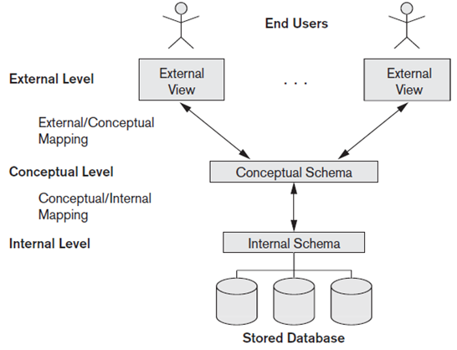
Three Schema Architecture
External/view Level → number of external user views. Each external schema describes the part of the database that a particular user group is interested in.
Conceptual Level Schema → structure (entities, data types, relationships, user operations, constraints) of whole database for a community of users.
Internal Level Schema → physical storage structure of database ie. complete details of data storage and access paths for the database.

Slide 18
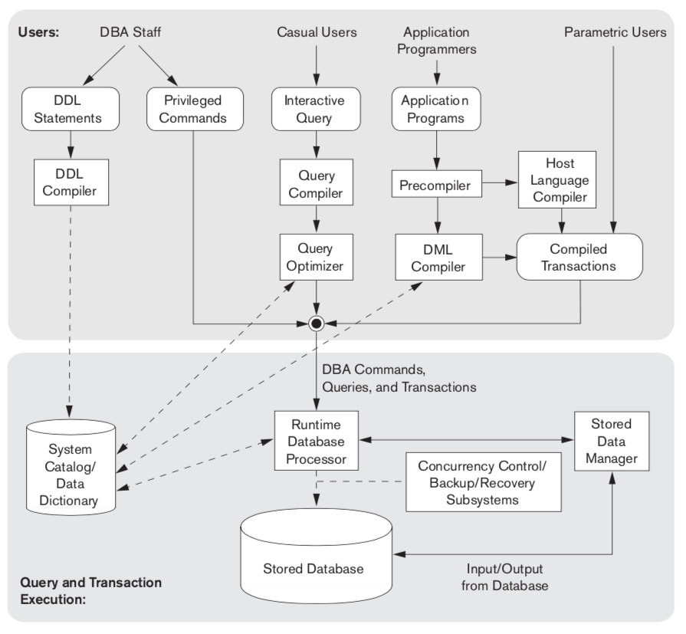
Component Modules of a DBMS

Slide 19

Relational DBMS
Integrity Constraints of RDBMS → Tabular Form
Record/ Tuple
Attribute/Field
No. of Records = Cardinality No. of Attributes = Arity

Slide 20
Relational Schema v/s Instance
Relational Schema: definition/structure of DB Table
Example:
EMPLOYEE (Fname, Minit, Lname, Ssn, Bdate, Address, Sex, Salary, Super_ssn, Dno)
Relational Instance: set of records of relation at the point of time

Slide 21
Characteristics of Database Systems
Characteristics of Database System
Data Abstraction
Meta-data
Concurrent Access
Multi- User View of Data
Program-data Independence

Slide 22
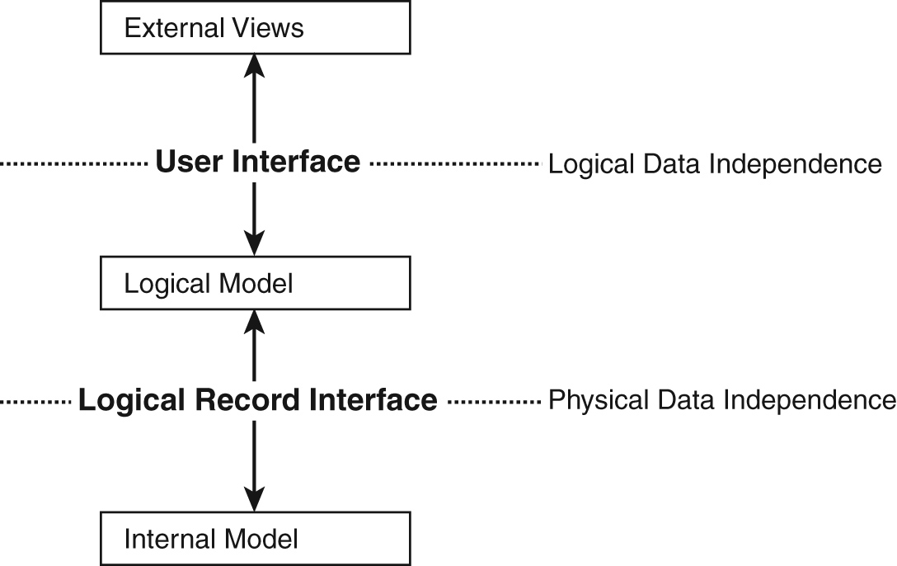
Data Abstraction & Program-Data Independence
Data Abstraction: A data model is used to hide storage details and present the users with a conceptual view of the database.
Program-data Independence: Allows changing data storage structures and operations without having to change the DBMS access programs.

Slide 23
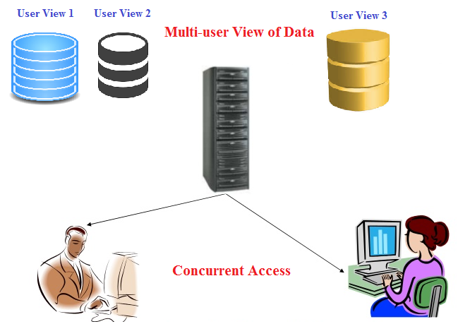
Concurrent Access & Multi-user View of Data

Slide 24
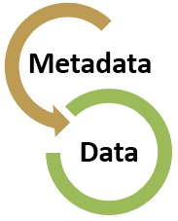
Meta-data
Meta-data: A DBMS catalog stores the description of the database. This description is called meta-data. This allows the DBMS software to work with different databases.
Self-describing nature of a database system

Slide 25
Client/Server Architectures
Two-tier Architecture
Three-tier Architecture
Client does extensive processing
Client does little processing

Slide 26
Application Logic in C/S Systems
Presentation Logic
Input – keyboard/mouse
Output – monitor/printer
GUI Interface
Processing Logic
I/O processing
Business rules
Data management
Procedures, functions,
programs
Storage Logic
Data storage/retrieval
DBMS Activities

Slide 27
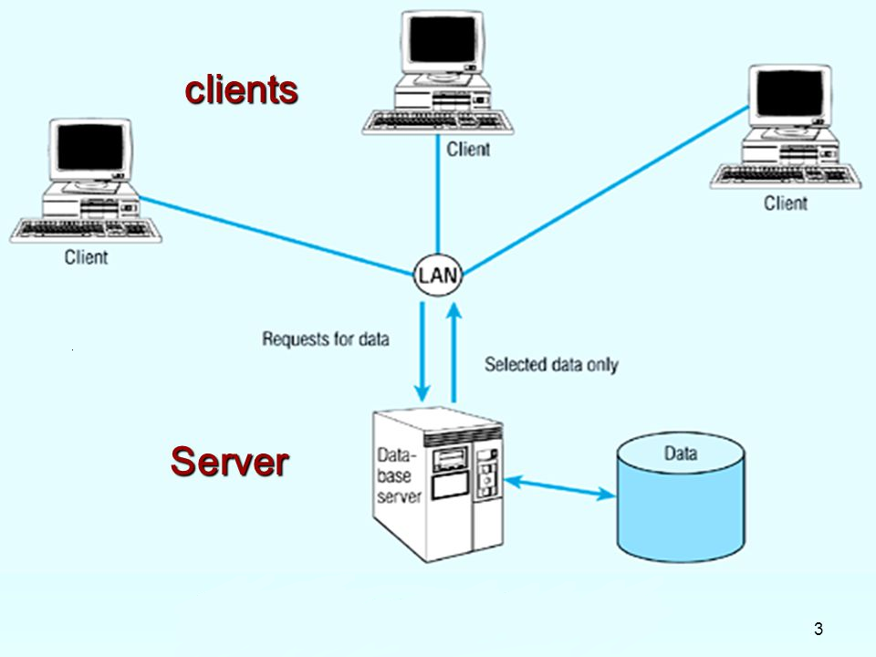
Two-tier Architecture
Responsible for I/O processing and
business rules logic
Server performs all data storage and
access processing →DBMS is only on server

Slide 28
Three-tier Architecture
Client
GUI
(I/O Processing)
Application Server
Business Rules
Web Server
Database Server
Browser
Data Storage
DBMS

Slide 29
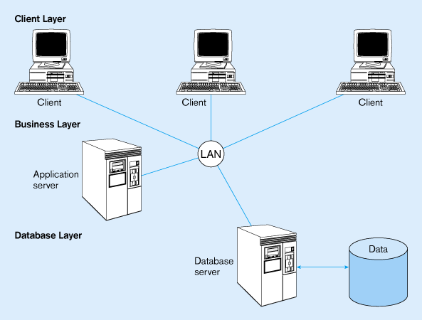
Three-tier Architecture

Slide 30
Database Query Languages

Slide 31
Data Definition language (DDL)
DDL - define the database structure or schema
CREATE - to create objects in the database
ALTER - alters the structure of the database
DROP - delete objects from the database

Slide 32
Data Manipulation language (DML)
DML – manages data within schema objects
SELECT - retrieve data from the a database
INSERT - insert data into a table
UPDATE - updates existing data within a table
DELETE - deletes all records from a table, the space for the records remain

Slide 33
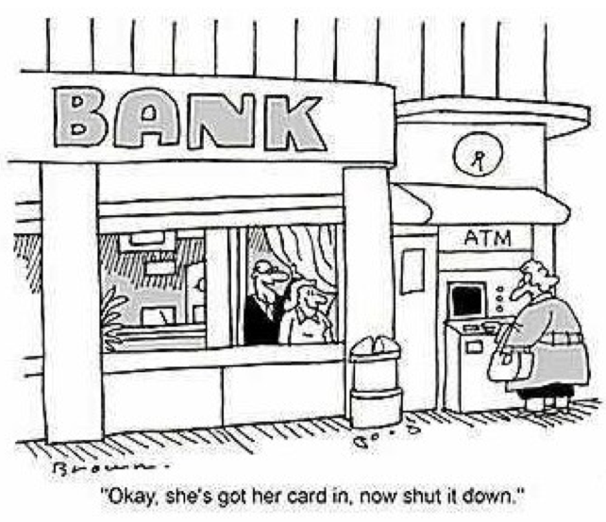
Data Control language (DCL)
DCL - used to control data access
GRANT - gives user's access privileges to database
REVOKE - withdraw access privileges given with the GRANT command

Slide 34
Transaction Control Language (TCL)
TCL - used to manage the changes made by DML. It allows statements to be grouped together into logical transactions.
COMMIT - save work done
SAVEPOINT - identify a point in a transaction to which you can later roll back
ROLLBACK - restore database to original since the last COMMIT rollback segment to use

Slide 35
Thanks!!

